Slide 1


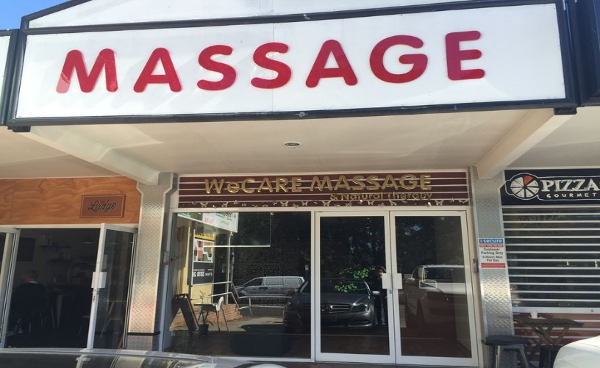
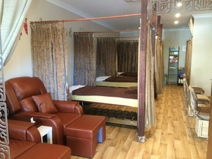
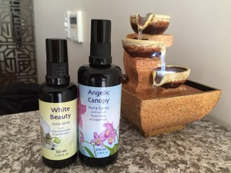

WECARE Massage & Natural Therapy
Welcome to WeCARE Massage store!
Searching
Sign In / Sign Up
Home
Treatment
Special
Online Booking
Career
About Us
Feature Careers
Treatment
Products

Slide 2
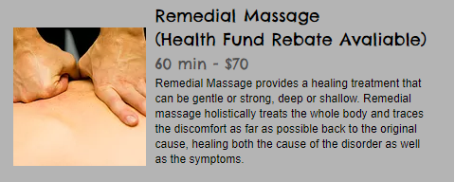
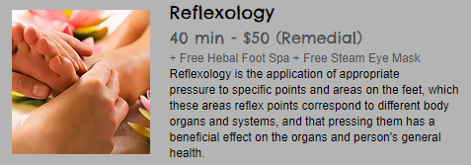
Today Special Treatment
>>>More specials
Welcome to WeCARE Massage & Natural Therapy
Professional in Remedial Massage & Relaxation
OPEN 7 DAYS
TREATMENT
​Headache relief
Neck movement recovery
Sciatica treatment
Pregnancy relaxation
Remedial reflexology
Lymphatic Drainage
Sports massage
ADDRESS
WeCARE Massage &
Natural Therapy
﻿﻿Shop 8/974 Waterworks Road.
The Gap, QLD 4061
Brisbane, Queensland, Australia
OPENING HOURS
Mon: 9:00am - 5:30pm
﻿Tue: 9:00am - 5:30pm
﻿Wed: 9:00am - 5:30pm
﻿Thurs: 9:00am - 8:00pm
﻿Fri: 9:00am - 5:30pm
Sat: 9:00am - 5:00pm
﻿Sun: 10:00am - 4:00pm
© 2017 by The WeCARE Massage & Natural Therapy.

